Slide 1
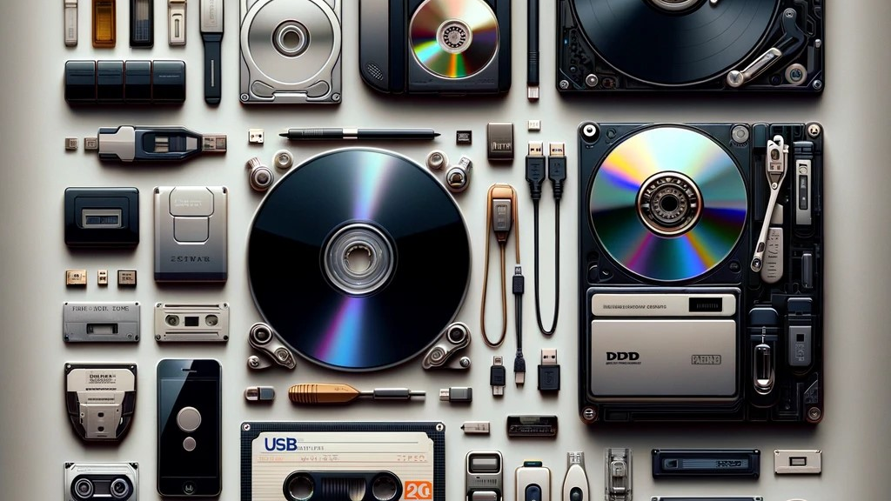
PIDs & university interests
Persistent Identifiers - DeiC Webinar 24/06/2025
Susanne den Boer, senior executive advisor
University of Copenhagen
susanne.denboer@adm.ku.dk

Slide 2
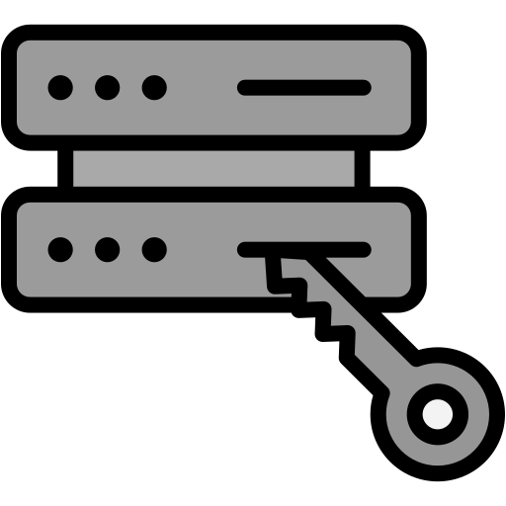



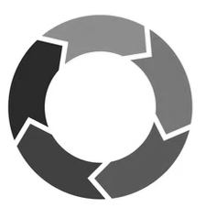
Why would universities be interested in PIDs?
1. Long-Term Access / Preservation
PIDs ensure research data (& other outputs) remain accessible.
= Research can be verified. Researchers can respond to enquiries
2. Improved Research Visibility and Impact:
PIDs ensure discoverable, citable, trackable researchers and output = = Increased global exposure. Boost to institutional reputation
3. Institutional Cohesion
PIDs can link research outputs together in one place
= Better overview of research output
4. Accurate Attribution and Disambiguation:
ORCIDs distinguish researchers across careers and affiliations
= Better attribution of research contributions
5. Improving research project administation :
PIDs can support research project management across systems, including researchers (ORCID), grants (grant IDs), collaboration partners (ROR), physical samples (IGSN), data collections (DOI), research equipment (DOI), to publications (DOIs).
= More efficient research project administration
Reflected in:
DK Code of Conduct for RI
DK FAIR strategy
UCPH RDM Policy
UCPH (DeiC) Dataverse
UCPH/DK(?) Metadata catalogue
NIS2
Strong recommendation for ORCIDs at UCPH
No current practice!
Many standalone systems!
What about at other universities?
Notes:
##-AccessibilityAssistant: Skip layout check-##

Slide 3
Summary
PIDs help universities to be compliant to stakeholder requirements
PIDs can positively contribute to universities’ “reputation”
PIDs can make research admin more efficient and reporting easier
But no consolidated focus on PIDs yet at UCPH ☹
PID policies could be a good idea! National alignment is a plus!
Policy elements? (with inspiration from the ARDC)
Require/Promote researchers to register and maintain an ORCID.
Assign DOI to published research outputs.
Adopt ROR to standardize institutional affiliation, funders.
Use IGSN for identifying physical samples
Create rich metadata when minting DOIs
Ensure integration of PIDs in all relevant research systems (Dataverse/local data repository, Pure Research Portal, Digital DM/DMP Tools, Funding management systems?, HR systems?)

